Slide 1
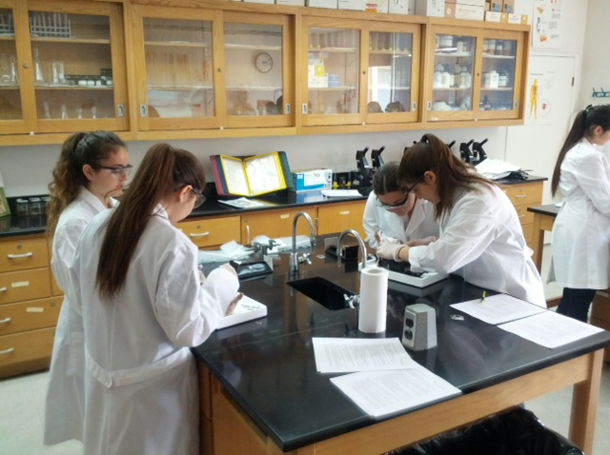
Science Labs and Scaffolded Writing Worksheets as Performance Tasks
Location
8:30 – 3:30 pm
February 2, 2015
CFN 603

Slide 2
Contact Information
Website: http://nysciresourcespd.weebly.com
Email: gcarlin@schools.nyc.gov
Blackberry: 917-714-7448
Desk: 718-828-5943

Slide 3
Workshop Objectives
1. Define/Describe a Performance Task for a Science Course
2. Describe how Laboratory Experiences can be modified to become Performance Tasks
3. Introduce the Scaffolded Writing Worksheet as strategy to support Laboratory Experiences and/or create Performance Tasks

Slide 4
Take 5
Please take turns sharing your Performance Tasks. Think about …
What worked well
How you set it up
How you got the idea
What students liked best
The texts you selected
How long it took
Feedback from your colleagues
What you might add to it next time

Slide 5
Anticipatory Set: PT, Lab, SWW
A Performance Task is a(n) … ? | 2. A Performance Task builds on … ? | 3. The most difficult part of writing a PT is … ?
4. The components of a typical science lab are … | 5. A science lab report rubric would mostly likely include … | 6. A science lab could be a performance task if …
7. The most effective worksheet, graphic organizer, or template for writing ask students to … | *8. What do you think a Scaffolded Writing Worksheet (SWW) is … ? | 9. A *SWW could be a Performance Task if … ?

Slide 6
“General Performance Task”
Definition
Parts: Description & Function
Process Steps
Problem: Identifying a Task – Especially one that Reflects “ARGUMENT” (CCLS/CIE)

Slide 7
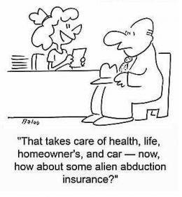
A Performance Task is …
is an activity or assignment or series of activities or assignments that is completed by the student
Is goal-directed, assessment exercise judged by the teacher or other evaluator on the basis of specific performance criteria.
Is strategically placed in the lesson
or unit to enhance learning as the
student “pulls it all together.” NOT
“add-ons” at the end of instruction.

Slide 8
Performance Tasks build on Earlier …
Content Knowledge: NYS MST Standards
CCLS Standards/Skills: Reading, Writing, …
Process Skills: Observing, inferring, measuring, communicating, classifying, predicting, formulating hypotheses, experimenting, …
Work Habits: Time management, individual responsibility, honesty, persistence, and intrapersonal skills …

Slide 9
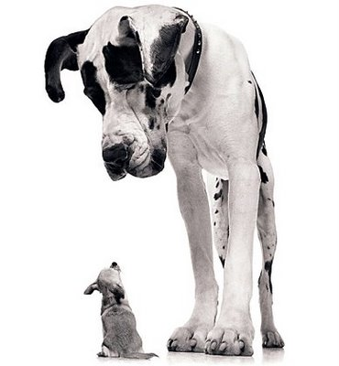
PT’s Build Over Time
Performance tasks range from short activities taking only a few minutes to projects culminating in polished products for audiences in and outside of the classroom.
In the beginning, most
performance tasks should
fall on the short end of the
continuum. Build Over Time

Slide 10
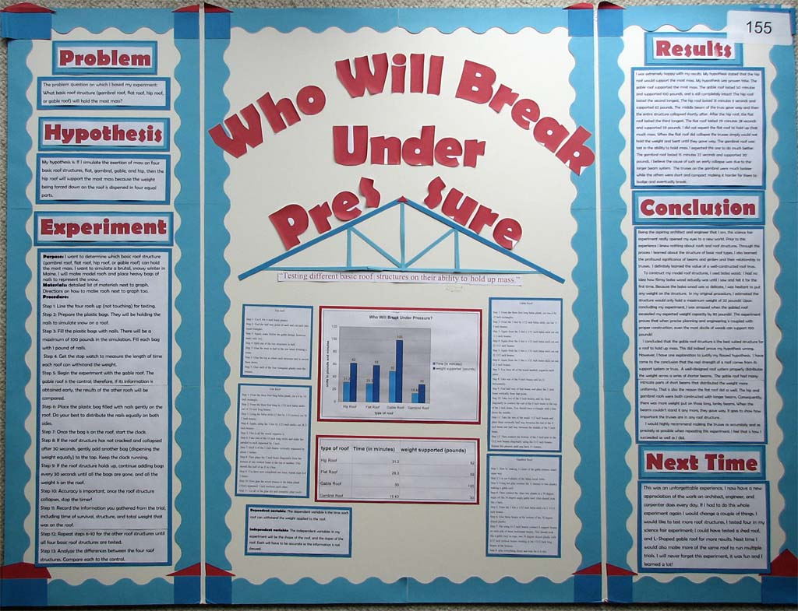
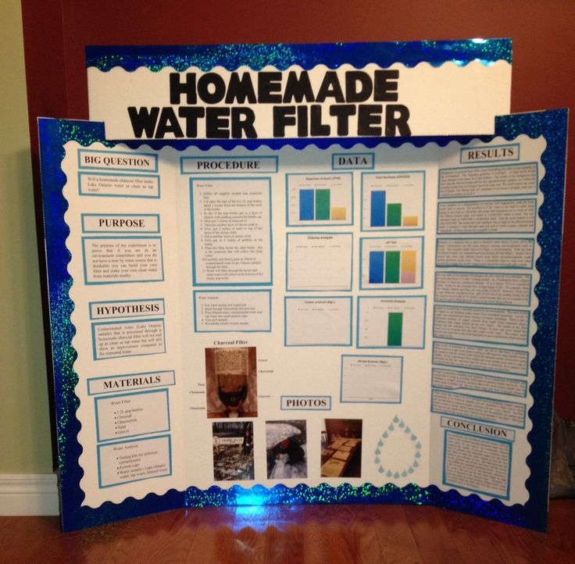
Design a Performance Task
1. Determine a Focus
2. Create a Context
3. Deciding on an Audience
4. Writing the Directions
5. Developing a Scoring Guide
6. Review and Revise the Task

Slide 11
Determine a Focus
Target an Academic Expectation or a Content/CCLS Standard (Learn & Do)
Start with One Expectation/Standard and additional can be added over time.
Determine the Evidence of
Learning (Do to Prove Learning)
– Basis of Rubric
ARGUMENT!

Slide 12
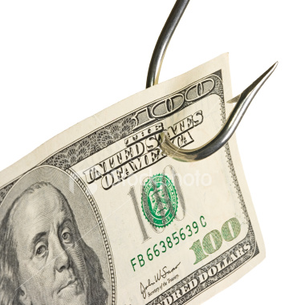
Create a Context
Explanation as to why the task is worth doing
Choose a significant Question or a Real-World Problem or Application
Develop a Background
Story or Scenario (“hook”
to engage students)

Slide 13
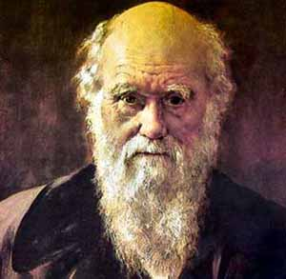
Deciding on an Audience
Identify an Authentic Audience – when possible
Holds students Accountable for Quality Work
Inside or Outside
of the Classroom
Simulated Audience:
Jury, Customer, Scientist

Slide 14
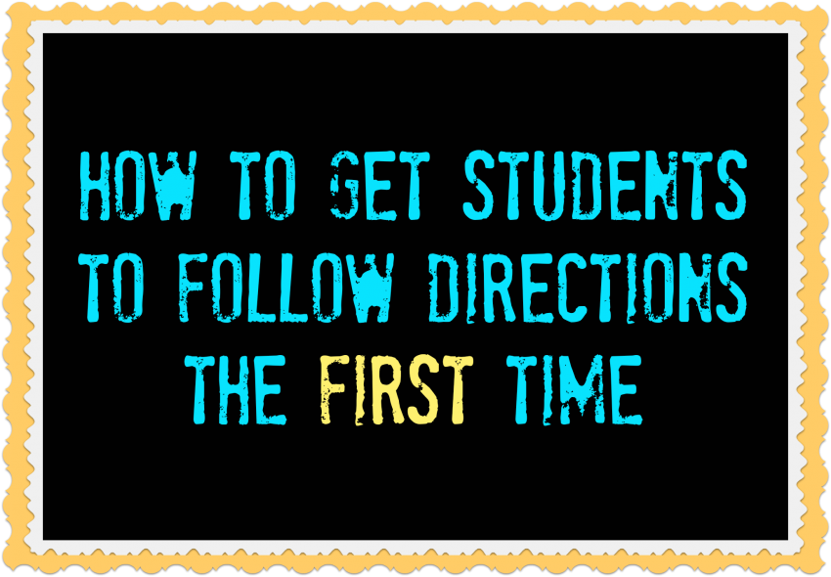
Writing the Directions
Describe in Clear Language What Students are Expected to Know and Do
Describe the Product of Performance (Skill) students are expected to develop
Specific instructions
to students – appropriate
level of detail to outline
how students are supposed
to complete the task

Slide 15
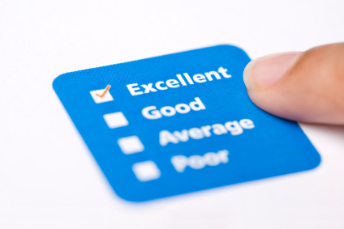
Developing a Scoring Guide
Based on Evidence of Learning or Standard(s)
Write a Descriptor of a Quality Performance
Determine an appropriate
Number of Performance Levels
Write Descriptors for all
Performance Levels

Slide 16
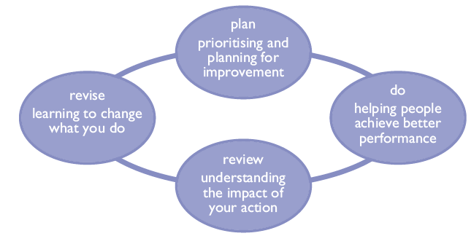
Review and Revise the Task
Cyclical Process: Stand-Alone prior to Implementation, then Requires Student Work
*Add Academic Expectations or Content/CCLS Standards
*Revise/Complete
the Scoring Guide

Slide 17
Now Create Your Own??? REALLY?
Citywide Instructional Expectations (CIE)
One Performance Task for Each Unit – 9/Year
CCLS Focus: Argument
Science vs. English!

Slide 18
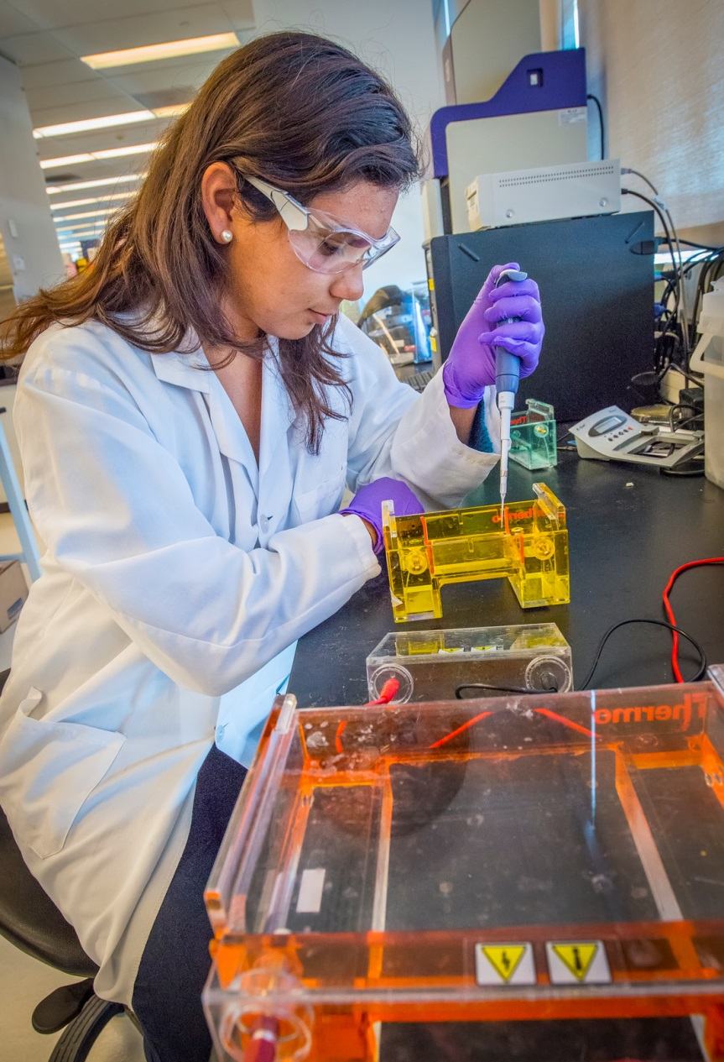
Turn & Talk
1. What are the typical parts of a science lab?
2. What is the definition of a laboratory experience?
3. What is the purpose(s) of a laboratory experience?
4. What makes an effective lab experience for Students?

Slide 19
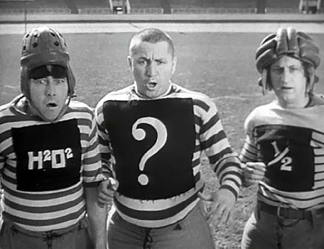
Critique a Lab: Read, Write, Pass
Quick Review (Read) of a
Laboratory Experience
Write one comment on a Physical Component (SEE) and one comment on the Opportunities (DO) of the laboratory experience
Pass to the next group partner – Repeat …

Slide 20
Typical Parts of a Science Lab
AIM/Question/Lab Name
Introduction
Diagrams (Concept/Process, Steps, Structure, …)
Materials List (w/Safety Considerations)
Directions/Procedure
Fill-ins (Hypothesis, Observation, Question, …)
Boxes (Observation, Results, Sketch, Label, … )
Data Table/Graph
Summary Questions/Discussion/Conclusion
Cut-Out Materials

Slide 21
A Laboratory Investigation or Lab
“An experience in the laboratory, classroom, or the field that provides students with opportunities to interact directly with natural phenomena or with data collected by others using tools, materials, data collection techniques, and models.”
Labs should correlate closely with classroom teaching and not be separate activities. And be thoughtfully sequenced into the flow of classroom instruction.

Slide 22
Learning Goals (Purpose) for Laboratory Experiences
Enhancing mastery of subject matter
Developing scientific reasoning
Understanding the complexity and ambiguity of empirical work
Developing practical skills
Understanding the nature of science
Cultivating interest in science and in learning science
Developing teamwork abilities
Notes:
The committee found that there is no consensus among policymakers, educators, and researchers about the purposes—or even the basic definition—of laboratory experiences. The committee concluded that science education must include opportunities for students to learn about both the process and content of science. Laboratory experiences teach students about the scientific process by enabling students “to interact directly with the material world (or with data drawn from the material world), using the tools, data-collection techniques, models, and theories of science.”

Slide 23
Most Effective Lab Experiences
Are designed with clear learning outcomes in mind
Investigate appropriate questions
Explore familiar phenomena and materials.
“Provide opportunities to design investigations, engage in scientific reasoning, manipulate equipment, record data, analyze results, draw and evaluate conclusions based on quantitative evidence and discuss findings/solve problems”.
Calibrate and troubleshoot equipment used to make observations
Debate what the evidence best supports a position
Apply the concepts and experimental results to the real world
Incorporate ongoing student reflection and discussion
Critique the ideas and findings of others

Slide 24
Classifying Your Science Labs
1. Create 3-6 categories by which you could separate your Laboratory Activities for your science course.
TIP: What is the general purpose of each lab?
2. Physically separate your Laboratory Activities in your categories and fill in the “Types of Science Labs” Template.

Slide 25
Types of Science Labs

Slide 26
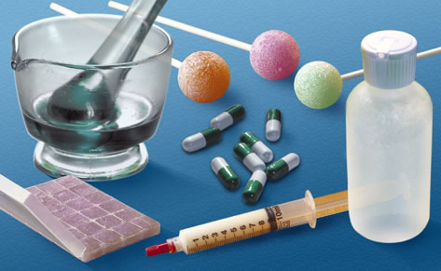
Types of Science Labs
1. Skill (Learn or Practice)
2. Observe a Process/Effect
3. Models and Simulations
4. Confirm a Known Value
5. Relationship:
The Effect of X on Y

Slide 27
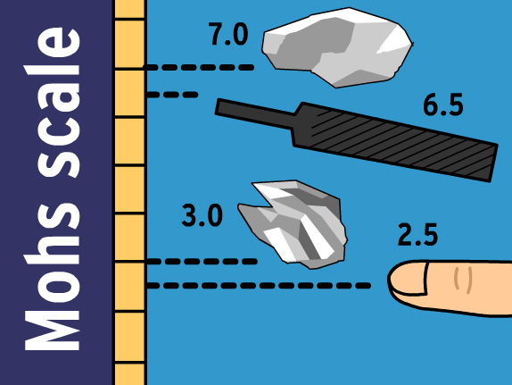
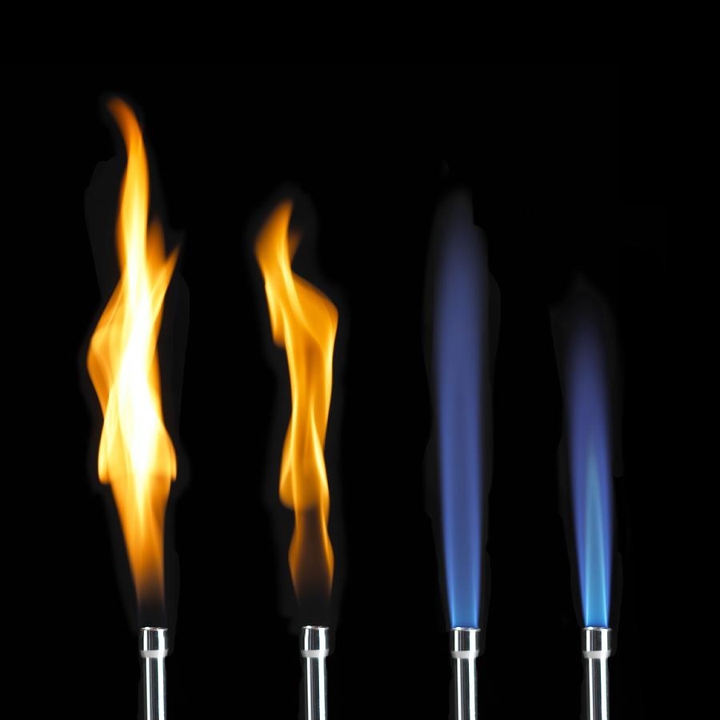
1. Skill Labs
Safety
Measurement
Microscope
ESRT
Density
Graphing
Slides Preparation/Staining
Bunsen Burner
Mineral Identification
Station Models

Slide 28
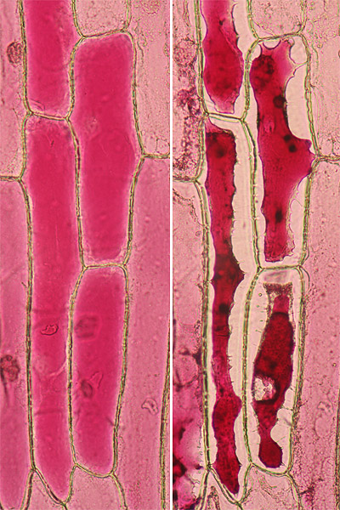
2. Observe a Process/Effect
Plasmolysis
Budding Yeast
Mitosis
Weathering
Flame Test
pH
Visible Spectrum
Relative Humidity/
Dewpoint

Slide 29
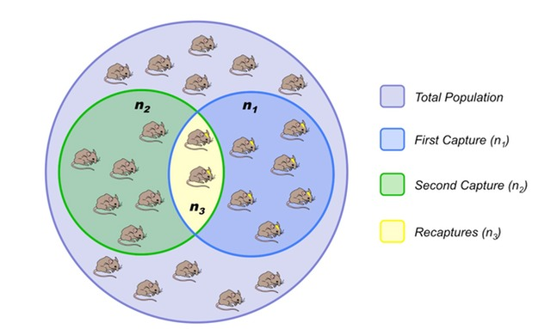
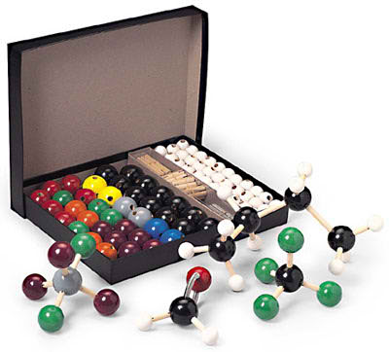
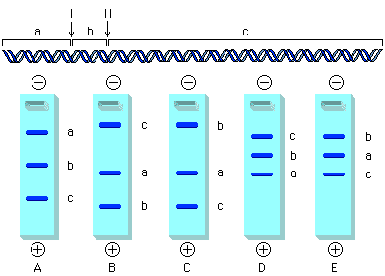
3. Models and Simulations
Molecular Models
Half-Life Simulation
Lincoln Index
Gel Electrophoresis
HIV and AIDS

Slide 30
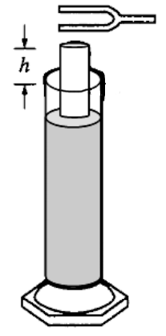
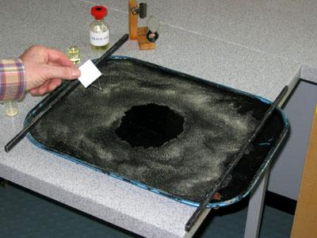
4. Confirm a Known Values
Speed of Sound
Series and Parallel Circuits
Diameter of a Cell
Size of a Molecule
Mitotic Index
Reaction Time
Density of Metals
Earthquake Epicenter
Genetic Corn

Slide 31
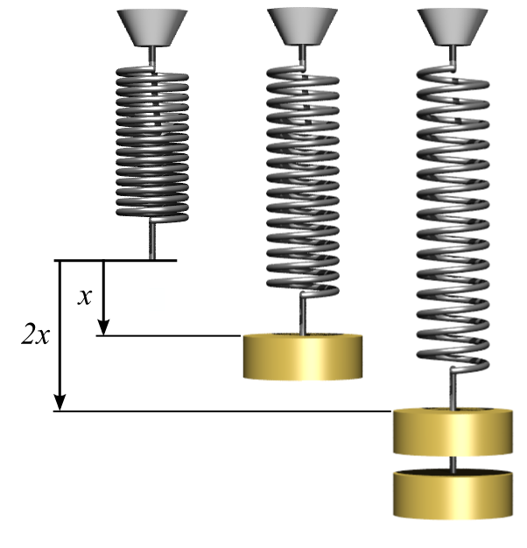
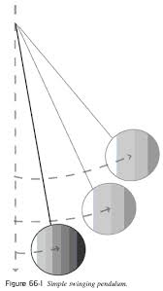
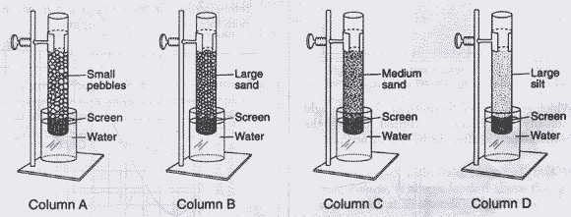
5. Relationships
Hooke’s Law
Simple Pendulum
Momentum (mass x velocity)
Permeability
Pulse Rate and Exercise

Slide 32
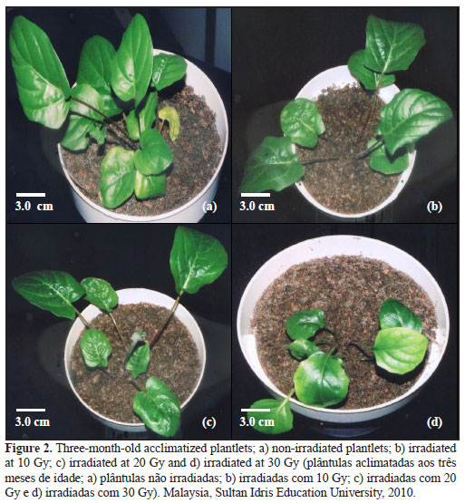
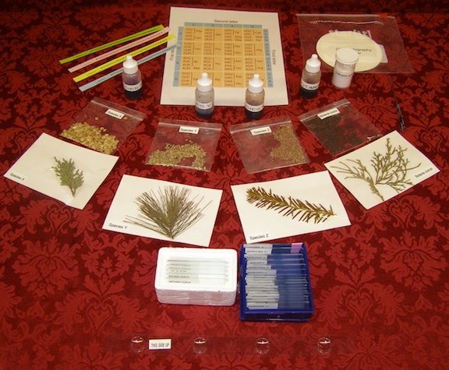
6. Solve/Add/Change
Crime Scene Suspect
Biodiversity Lab
Add a Variable
“Continuous Variable”
Change a Condition
Add another condition
New or Unique condition

Slide 33
Types of Science Labs
1. Skill | 2. Observe a Process/Effect | 3. Models and Simulations
Safety, Measurement Microscope, ESRT Density, Graphing Slides Preparation/Staining Bunsen Burner Mineral Identification Station Models | Plasmolysis Budding Yeast Mitosis Weathering Flame Test, pH Visible Spectrum Relative Humidity/Dewpoint | Molecular Models Half-Life Simulation Lincoln Index Gel Electrophoresis HIV and AIDS
4. Confirm a Known Value | 5. Relationship | 6. Solve/Add/Change
Speed of Sound Series and Parallel Circuits Diameter of a Cell Size of a Molecule Mitotic Index Reaction Time Density of Metals Earthquake Epicenter Genetic Corn | Hooke’s Law Simple Pendulum Momentum (mass x velocity) Permeability Pulse Rate and Exercise | Crime Scene Suspect Biodiversity Lab Add a Variable “Continuous Variable” Change a Condition Add another condition New or Unique condition

Slide 34
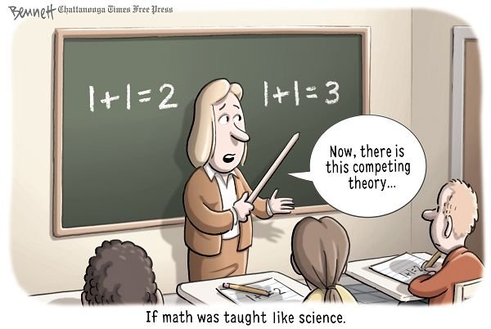
Claims & Arguments in Science

Slide 35
Are Labs Performance Tasks?
… Are there Arguments we can make?

Slide 36
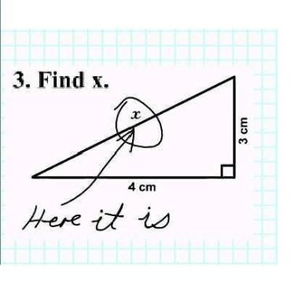
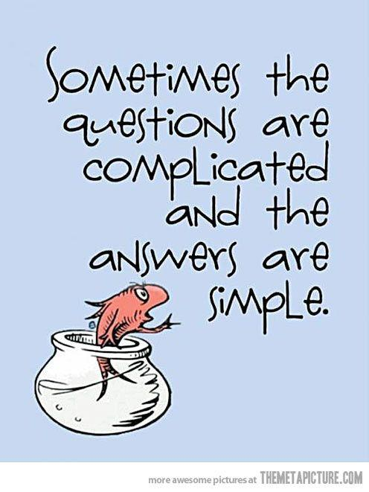
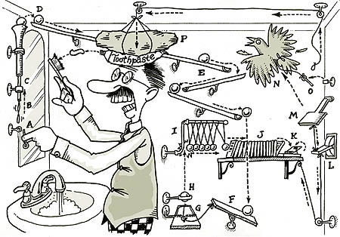
Let’s Keep it Simple

Slide 37
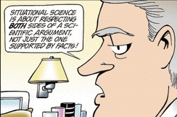
CCLS: Claim & Argument
CLAIM: “State or assert that something is the case, typically without providing evidence or proof.”
ARGUMENT: “A reason
or set of reasons given
with the aim of persuading
others that an action or idea
is right or wrong.”

Slide 38
In the Simplest Sense…
A CLAIM could be a HYPOTHESIS or a PREDICTION
What happens in the Laboratory Experience will then be the REASONS (Evidence) to support your Hypothesis or Prediction (Claim)
We most often see this in labs that Observe a Process/Effect, Models & Simulations, and when we look at a Relationship

Slide 39
Change Our Paradigm
REGARDLESS OF THE TYPE OF LAB …
Goal of a laboratory experience is to either start with a claim (FACT) OR arrive at a claim that uses the observations/data as your evidence (reasons) to support your claim.
In other words – Laboratory experiences should allow us to arrive at fact(s) ourselves through a specific activity or series of activities
Ideally, factual claims arrived by ourselves should match those reported by others in primary and secondary sources

Slide 40
Where do these FACTS come from?
Standards (Content, Skills, Process)
Key ideas (Examples)
Performance Indicators
Major Understandings
Appendix A (Lab Skills)
Appendix B/C

Slide 41
Sea Urchin Eggs: Cleavage & Gastrulation
Standard 4: Students will understand and apply scientific concepts, principles, and theories pertaining to the physical setting and living environment and recognize the historical development of ideas in science.
KI 4: The continuity of life is sustained through reproduction and development
PI 4.1: Explain how organisms, including humans reproduce their own kind
MU 4.1d The zygote may divide by mitosis and differentiate to form the specialized cells, tissues, and organs of multicellular organisms

Slide 42
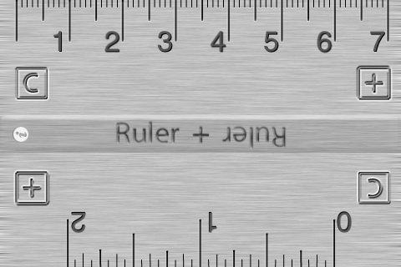
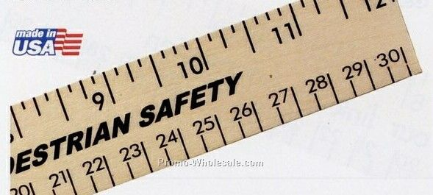
Skill Lab: Metric Measurement
Appendix A: Selects and uses correct instruments.
Uses Metric ruler to measure length
1.2b Inquiry involves making judgments about the reliability of the source and relevance of information
PI 2.2a … Recommendations for methodologies, use of technologies, proper equipment, and safety precautions should also be included.
Notes:
In the psychometrics, reliability is the overall consistency of a measure. A measure is said to have a high reliability if it produces similar results under consistent conditions. For example, measurements of people’s height and weight are often extremely reliable

Slide 43
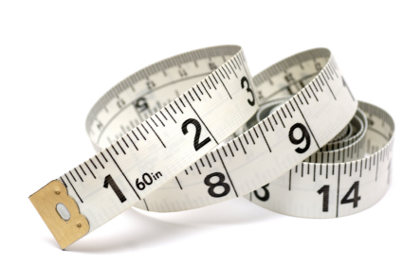
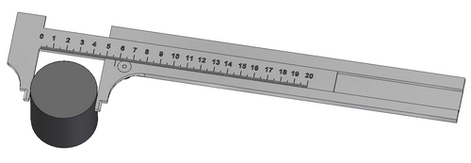
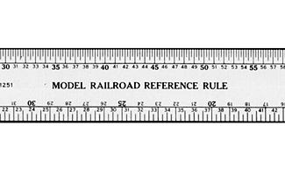
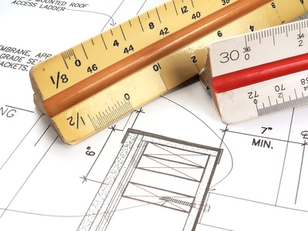
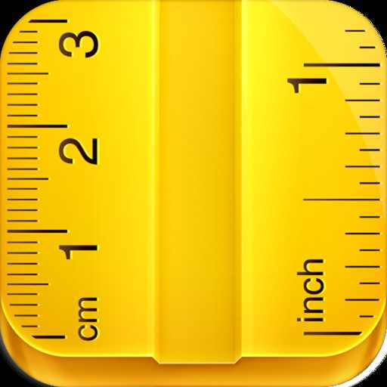
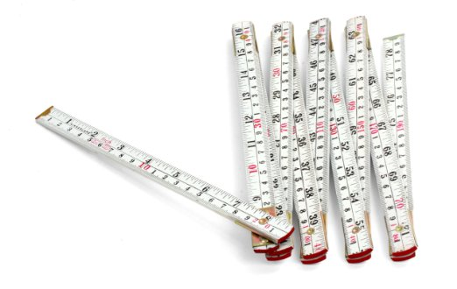
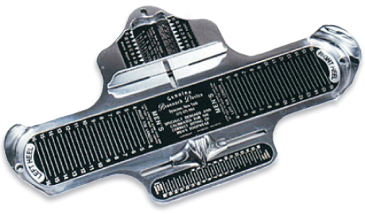
Proper Equipment

Slide 44
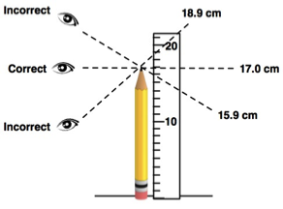
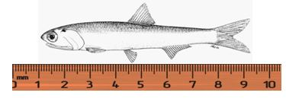
Methodologies
A set of agreed upon ways (rules, practices) of doing something (technique, procedure, process, etc.)

Slide 45
Use of Technology
Scale: Appropriate Scale (mm)
Do not start from end/zero
Looking straight down at the ruler
Correct use of Significant Figures (hundredth)
Reliability (Consistency) of Source
Come from the Instrument Selection, Follow Specific Practices, Experience of User

Slide 46
Laboratory Reports
FACTUAL Argument that summarize a set of activities.
Summary of Steps you Followed – How/Why, including any adjustments/corrections/etc., Equipment/Technologies Used
Data (Results) – Organized, Represented, Analyzed
Written Explanation of how the “laboratory experience” enhances the current lesson(s) and/or unit and how the data (evidence) support your argument claim in terms of the identified Content Standards

Slide 47
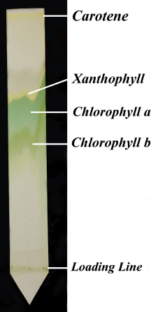
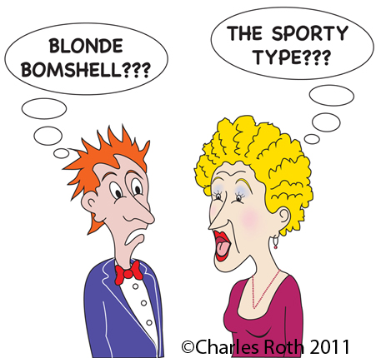
Compare to Known Values

Slide 48
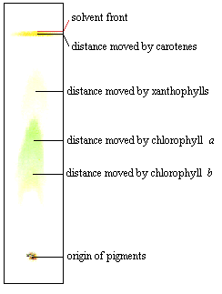
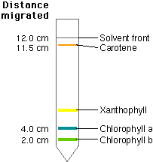
Paper Chromatography

Slide 49
Retardation Factor (R_{f}): Migration distance of pigment/Mig dist of solvent Paper Chromatography
Pigment Color Rf
Carotene Yellow 0.95
Phaeophytin Yellow-Grey 0.83
Xanthophyll Yellow-Brown 0.71
Chlorophyll a Blue-Green 0.65
Chlorophyll b Green 0.45

Slide 50
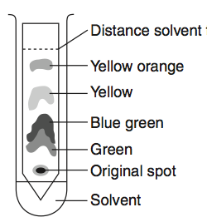
Comparison Sentence Starter
Based on your knowledge of (Type of Science, i.e. Biology & Chromatography), how well do the results in the diagram reflect the expected results?
EXPLAIN in Writing
label diagram
describe steps
Show/describe work
Argument: Claim/Evidence

Slide 51
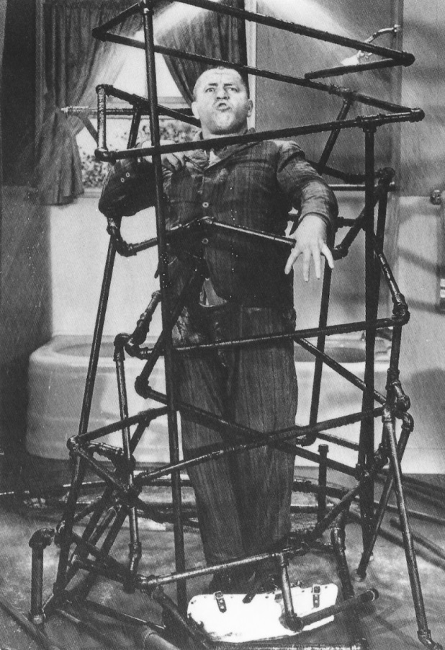
PIT: Put It Together
Justify Reasoning
Connect Ideas and/or Concepts
Create an Analogy
Draw and Support a Conclusion
How are you using the data from the lab activities
to support your Claim?

Slide 52
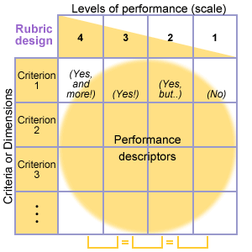
Requires a Rubric
Scoring Guide to evaluate the Critical Attributes (content, process, skill) of lab
Specific to each lab
Analytic to provide targeted feedback

Slide 53
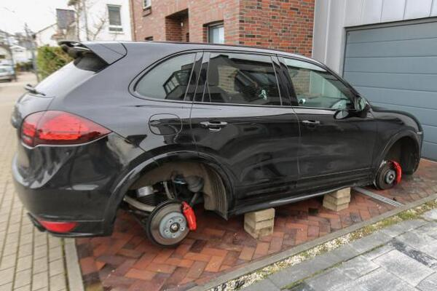
Unfortunately, One Day …
What do I do?
Buy 4 New Wheels!!!
What Size Wheel do I Need?

Slide 54
Real World Connection
Getting the Correct
Wheels for Your Car
Using a metric ruler,
measure the diameter
of the lug nuts by
following the diagram. It’s very important
to ensure that your measurements are accurate or your new wheels won’t fit properly. (What is unique about the 5-Lug?)

Slide 55
Make a CLAIM in ANY Lab!
1. Determine the TYPE of Lab
2. Is a HYPOTHESIS or PREDICTION asked for?
YES – CLAIM – Core Curriculum to Connect to a Standard, Skill: Lab or Process
NO – Core Curriculum (Need a FACT for a Claim!)
Core Curriculum http://www.p12.nysed.gov/ciai/cores.html
OR Connect to a Science Standard (KI -Example, PI, MU)
(Content, Skill, or Process) --- CLAIM
OR Connect to an APPENDIX A – Laboratory Checklist
OR Connect to a SKILL – APPENDIX A: Standards 1,2,6,&7 Checklist
Appendix B: Standard 4 Process Skills
Appendix C: Process Skills Connections

Slide 56
Arguments in Science Labs
Reasons (Evidence) is needed to support our Claim --- this represents our ARGUMENT
Evidence to support our ARGUMENT comes from the Data (observations) we collect during the lab activities
In some cases, we can make the Claim at the start of the lab, while in some cases we must complete all the lab activities before we can make a CLAIM and argue our position.

Slide 57
Laboratory Reports & Arguments
Ultimately, Laboratory Report should be to show how the activities of the lab support Hypothesis/Prediction/Claim
Opportunity to connect/compare to an additional Primary or Secondary text (a paragraph or longer)
Your FINAL job should be to REFLECT on your Argument and the evidence you collected.

Slide 58
Laboratory Reflection Questions
How well did you conform to scientific practices to maintain reliability of your results?
How did the materials, equipment, and procedure(s) impact on the strength of your evidence to support your claim?
What are the limitations of the evidence (data) in terms of supporting your claim?
How well does your Laboratory Report demonstrate your understanding of the Learning Outcomes?
What would you do next (new data/evidence) or modify to strengthen your claim? Explain
How would you explain any anomalous data or deviations from what was expected?
How does previous lab/classroom findings or information support /refute, add to, or bring new questions to light?
Is there any other way your data (evidence) could be analyzed to support a different/modified claim? Explain.
What skills within the lab do you or your group need more support with and how will you get that support? Explain
How would you utilize the concepts/skills of the lab experience to address a real world application that is meaningful in your life or connects to a familiar phenomena?
How well did your findings conform to the findings of other lab groups, predicted values, expected/theoretical values, or previous lab results?

Slide 59
How can Existing Lab become PTs? Confirm or Add in …
Learning Outcomes
Standards (MST and CCLS):
KI (example), PI, MU, Appendix
Claim
Procedure Summary:
How, Why, Modifications, Tool Protocol, Technology
Assessment Questions for Each Activity
Text (Paragraph/+) – In addition to the Introduction
Written Argument
Reflection Question(s)
Rubric

Slide 60
Also Used in a Series of Writings as a Performance Task
Scaffolded Writing Worksheet Series
Performance Task

Slide 61
Series of Writing Tasks as a Performance Task
First Task might provide an opportunity to address initial content or provide a lab experience
Second Task now expands upon the content and makes new connections and/or provide a lab experience
Third Task+ allows students to (PIT) Put It Together and Explain/Argue In-Depth in a Lab that collects actual data as evidence!

Slide 62
Scaffolded Writing Worksheet (SWW)
Goal: Develop Student Writing through a Progression of Texts with Guiding Questions
Questions: are scaffolded so initial questions allow entry for all students, then increase in rigor, ultimately leading to a final task (Argument) which incorporates information from all student responses.

Slide 63
SWW Components
Text(s) – Annotation
Can be used to used Processes/Procedures
Writing Prompts/Questions – Scaffolded
Series of Worksheets (3-5) – Multiple Days
Questions from successive Worksheets require information from prior Worksheets
Use Additional Texts, Notes, Research
Cumulative Writing Task (Argument)
Rubric for Feedback/Self-Assessment

Slide 64
SWW: Series of Worksheets
Done over multiple Days – as Activities within the lessons
Allow students to “Write routinely over … shorter time frames for a range of tasks, purposes …” CCLS Writing Standard #9
A Laboratory Report could represent one of the Scaffolded Writing Worksheets within a series (Initial, Intermediate, or even Final)

Slide 65
CCLS READING: Standards
1. Read closely to determine what the text says explicitly and to make logical inferences from it; cite specific textual evidence when writing or speaking to support conclusions drawn from the text.
2. Determine central ideas or themes of a text and analyze their development; summarize the key supporting details and ideas.
3. Analyze how and why individuals, events, or ideas develop and interact over the course of a text.

Slide 66
CCLS WRITING Standards
1. Write arguments to support claims in an analysis of substantive topics or texts using valid reasoning and relevant and sufficient evidence.
8. Gather relevant information from multiple print and digital sources, assess the credibility and accuracy of each source, and integrate the information while avoiding plagiarism.
9. Draw evidence from literary or informational texts to support analysis, reflection, and research.

Slide 67
Texts
Use Regents Reading Passages
Lexile Appropriate (Can Build)
Leave Room for Annotation
If Necessary – Alternate Texts to meet the needs of all students
Notes:
Lexile.com

Slide 68
Annotation
Annotation Marks
Identifiers
Evidence
Specific Example
Vocabulary
Questions
Connections
Prediction

Slide 69
Writing Prompts/Questions
Regents: M/C and Constructed Response
Adapt Key Ideas and Major Understandings
Line Spacing is a Key to Expected Writing
1-2 “Entry Questions” before my High-Order Think Question for the Reading Passage

Slide 70
Additional Texts
Class Textbook
Student Notes
Additional Handout
Online Resource
Laboratory Report/Research

Slide 71
Cumulative Writing Task
Argument
Using what you have learned about ___ , ___, ___, … and your knowledge of ___ write an ARGUMENT with supporting evidence as to …
Argument will draw information from all Worksheets as well as additional texts!

Slide 72
SWW Rubric
Analytic as to give Feedback to specific criteria
Specific to writing an Argument in Science
Specific to Content and Skills (i.e. CCLS)
Rubric (self-reflection) should be addressed in the REFLECTION

Slide 73
Claim – CounterClaim in Science???
Living Environment:
Ethical
Cost-Effective
Safe
Position Opinion, etc.
Physical Science
Limited Specific Areas
Nuclear Energy, Earthquakes, Acid/Base Theories, Geologic History, Hurricane

Slide 74
MCQ: Find the Language … Create an Argument
… would most likely … | … would most likely affect … | … will/is most probably …
… most likely (due/describes) … | … likely result … | … best illustrates …
… most likely due to … | … best describe/supports … | … best explanation …

Slide 75
For Example …
Which activity would most likely increase the mutation rate in a culture of bacteria being grown in a laboratory experiment?
(1) adding more distilled water to the culture
(2) adding excess nutrients to the culture
(3) exposing the culture to a higher concentration of CO2
(4) exposing the culture to ultraviolet radiation

Slide 76
Additional Possible Explanations
In order to argue, you will need to create additional possible explanations such as:
(1) exposing the culture to an antibiotic such as penicillin for a prolonged period of time
(2) exposing the culture to a chemical mutagen such as nitrous acid
(3) introducing a virus (bacteriophage) to the bacterial culture

Slide 77
Modify the Question
Modify the original question so as to have something to argue about, such as greatest/least impact on an outcome.
Which activity would have the “greatest impact” on the mutation rate of a culture of bacteria being grown in a laboratory experiment?

Slide 78
Define the Quantifier
Students work together to decide how they will define “greatest impact”.
speed,
rate,
observable change,
detrimental/negative effect,
type of mutation produced, etc.

Slide 79
Creating 2 Choices
Which activity would have the “greatest effect” on the mutation rate of a culture of bacteria being grown in a laboratory experiment?
Exposing the culture to ultraviolet light OR
Exposing the culture to a chemical mutagen such as nitrous acid

Slide 80
Provide Informational Text
1. Ultraviolet light and mutations
2. Nitrous acid and mutations
Differentiated Sets (if possible) – address same content but scaffolded to different levels (visuals, add definitions, substitute words and visuals, etc.

Slide 81
ES Strategy
Which evidence best supports the Big Bang theory?
(1) rate of rotation of the Sun
(2) existence of cosmic background radiation**
(3) uniform radioactive decay of uranium-238
(4) separation of Earth’s interior into different layers

Slide 82
1. Brainstorm a list of possible answers to the M/C question
(1) Cosmic Background Radiation moving through space
(2) The amount of Helium in the universe
(3) Redshifts of galaxies and quasars
(4) The sky is dark at night
(5) There are no stars older than 13.8 billion years
(6) The discovery of dark matter and dark energy
(7) How the light curves from distant supernovae
(8) The ratio of hydrogen, helium, and other trace elements in the universe
(9) Velocities and distances of galaxies

Slide 83
2. Rephrase the question (so we will have something to argue about):
Which piece of evidence is “strongest” in supporting the Big Bang Theory?
3. Define “strongest” as a class
i.e. include more components, more widely accepted, how closely it meets a prediction, allow for the lease debate or possible explanations, most direct evidence, etc

Slide 84
4. Select two possible areas from which the argument will come from:
1. Redshifts of galaxies
2. The sky is dark at night (seems simple
but really isn’t)
5. Provide 1-3 articles (informational text) on the Big Bang Theory Evidence

Slide 85
Chemistry
Explain, in terms of the polarity of sugar molecules, why the sugar dissolves in water.
Question you’re being asked: How does polarity affect solubility of sugar in water?
More General statement: The nature of the solute/solvent affects solubility
To support a factual generalization, you must cite a number of the verified facts that have led to the general conclusion. The more sweeping the generalization, the more examples you will need to cite.

Slide 86
Verified Facts (Use to Create an Argument)
Factual Generalization: The nature of the solute/solvent affects solubility
Claims (verified facts) that support General statement | Specific example(s) that support Claim | Situations/Examples when Claim would not be true or NA
Balance of intermolecular forces …
Polar and Nonpolar molecules …
Entropy change …

Slide 87
Add an Evaluative Term
Once you support a factual generalization, we are ready to apply an EVALUATIVE term to a specific situation.
For example:
Water is the best solute to support life.

Slide 88
Arguing your Choice
Pose a definite statement for argument:
Polarity is the most important factor in determining solubility
This now allows you to state the reasons why polarity is an important factor and it also allows you to contradict specific claims using other factors in which the claim would not be true.

Slide 89
Create your Own Argument

Slide 90
EXTRA SLIDES

Slide 91
LE Laboratory Skills
Uses a compound microscope/stereoscope effectively to see specimens clearly, using different magnifications
Identifies and compares parts of a variety of cells
Compares relative sizes of cells and organelles
Prepares wet-mount slides and uses appropriate staining techniques
Makes observations of biological processes

Slide 92
Science Labs
A hallmark of science is that it generates theories and laws that must be consistent with observations.
Much of the evidence from these observations is collected during laboratory investigations.

Slide 93
Proper Laboratory Investigations
have a definite purpose that is communicated clearly to students
focus on the processes of science as a way to convey content
incorporate ongoing student reflection and discussion
enable students to develop safe and conscientious lab habits and procedures

Slide 94
1. Make the measurement with an instrument that has the highest level of precision. The smaller the unit, or fraction of a unit, on the measuring device, the more precisely the device can measure. The precision of a measuring instrument is determined by the smallest unit to which it can measure.
2. Know your tools! Apply correct techniques when using the measuring instrument and reading the value measured. Avoid the error called "parallax" -- always take readings by looking straight down (or ahead) at the measuring device. Looking at the measuring device from a left or right angle will give an incorrect value.
3. Repeat the same measure several times to get a good average value.
4. Measure under controlled conditions. If the object you are measuring could change size depending upon climatic conditions (swell or shrink), be sure to measure it under the same conditions each time. This may apply to your measuring instruments as well.

Slide 95
Any measurement made with a measuring device is approximate. If you measure the same object two different times, the two measurements may not be exactly the same. The difference between two measurements is called a variation in the measurements.
Another word for this variation - or uncertainty in measurement - is "error." This "error" is not the same as a "mistake." It does not mean that you got the wrong answer. The error in measurement is a mathematical way to show the uncertainty in the measurement. It is the difference between the result of the measurement and the true value of what you were measuring.

Slide 97
Take 5: Performance Task
What worked well? | How did you set it up? | How did you get the idea?
What did the students like best? | What texts did you select? | How long did it take the students?
Feedback from your Colleagues? | What you might to it for next time? | Your thoughts on its value to your Regents course?

Slide 98
Turn & Talk: Science Labs
1. What are the typical parts of a science lab? | 2. What is the definition of a laboratory experience?
3. What is the purpose(s) of a laboratory experience? | 4. What makes an effective lab experience for students?

